Slide 1
Microsoft Azure Machine Learning for the Absolute Beginner
Joel Cochran

Slide 2
Microsoft & Machine Learning Answering questions with experience
1991
1997
2008
2009
2010
2014
2015
Microsoft Research formed
Hotmail launches
Which email is junk?
Bing maps launches
What’s the best way home?
Bing search launches
Which searches are most relevant?
Kinect launches
What does that motion “mean”?
Skype Translator launches
What is that person saying?
Azure Machine Learning GA
What will happen next?
Machine learning is pervasive throughout Microsoft products.
Notes:
Microsoft has been working on machine learning for over two decades. We formed Microsoft research back in 1991 to tackle the tough problems internally that we’re enabling you to tackle yourselves today.
When we think of learning from experience – past data + human input – a great example is Hotmail. Back in 1997, external email was a relatively new concept. There wasn’t a lot to go on in terms of what email the customer wants and what they do not. With the rise of email, also came spam – and lots of it. Some of those issues were easy – like Nigerian princes we learned pretty quickly don’t give away their fortunes to strangers. But what about “free offer” – maybe that free offer is something the customer always wanted. Maybe it’s something they’d never want. But that’s where the “human input” part comes in as data is being collected – that takes the form of the actual user of the email service saying “yes, this is junk” or “no, I want this” and then the data scientist learning in aggregate and making tweaks to the underlying model in response.
And we kept going with that learning – relying on past data and human input to solve problems like the best way home, which search results are most meaningful to the user and one of the toughest ones to tackle with Kinect. Kinect’s past data was all in the lab – we didn’t have a product in market that captured user input and translated that to active game play so we had to make up the variables. But that only takes us so far. The researchers told me that one thing they didn’t consider was people answering the phone while playing. This happens a lot – and Kinect at first was translating this as a wild motion in the game play – essentially crashing people’s cars or any number of unintended consequences. That was the human input we rely on, which allowed us to learn quickly and adjust the underlying model to ensure that answering the phone would not be considered part of the game moving forward.
Skype translator is another huge machine learning problem to solve if you think of all the ways a person who is speaking English can pronounce the same word – tom-A-to or tom-AH-to – that’s the same word in French so Skype has to adjust quickly to ensure all the millions of variables are considered.
But what about using all this learning to predict what’s next? Many of the same algorithms running behind the scenes of our products in market today are available within Azure ML, allowing you to take your own past data and learn from it what will happen in the future for your business.

Slide 3
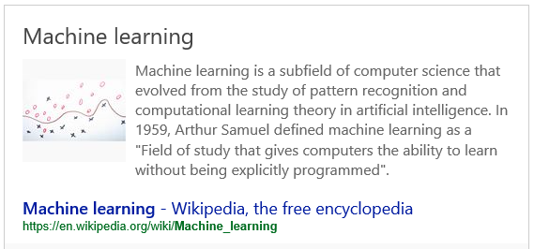

Slide 4




Is this dangerous?
Why would you think that?

Slide 5
How do people learn?
Exposure to facts?
Experimentation?
Repetition?
Experience?
All of the above?

Slide 6
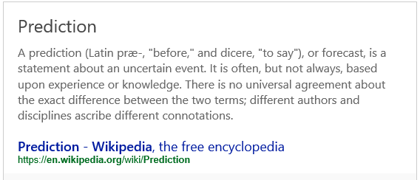
Will the sun come up tomorrow?
Who will win the World Series?
Are you likely to support a particular candidate?

Slide 7
Predictive Analytics
Pattern Matching
Data Modeling
Statistics
Algorithms
The future is now…

Slide 8
Machine Learning is all around you
Google and Bing: search result relevance
Amazon and Netflix: recommendation engines
Cortana, Skype, and Kinect: voice and facial recognition
Credit card companies and banks: fraud detection
Manufacturing and IoT: sensor processing
Future: Self-driving cars, medical diagnosis, legal decisions, credit and loan decisions, etc etc etc

Slide 9
Azure Machine Learning Service Data -> Predictive model -> Operational web API in minutes
Data
Clients
API
ML STUDIO
Model is now a web service that is callable
Blobs and Tables
Hadoop (HDInsight)
Relational DB (Azure SQL DB)
Integrated development environment for Machine Learning
Monetize the API through our marketplace
Notes:
So let’s take a look at the technology itself. The elegance of the solution is in its simplicity – something that has been lacking in the machine learning space which is a key reason this space has not improved in generations. But we are here to change this.
The first issue many enterprises face is data ingestion. With the cloud, you can bring in data sources with the ease of a drop down or drop your on-premises data set into the built in storage space. Users can then model in our development environment – Machine Learning Studio – where we’re offering R, Python and SQLite as first class citizens in addition to our world-class Microsoft algorithms.
The second issue – and often the primary one – is putting finished work into production in a way others can use. We’ve heard from many data scientists that they model in R on a Linux stack but then have to hand over their work to developers who need to translate that into another language to actually make it work. This time consuming and unnecessary process has been eliminated with our system, as the model is with a click transformed into a web service end-point that can run over any data, anywhere and connect to any solution or client.
Next, not only can this model be put into production for your company, it can be made available for the world on our Machine Learning Marketplace. Microsoft hosts your solution and markets it for you, while you have the freedom to brand and monetize as you see fit. We also offer a number of Microsoft solutions here.

Slide 10
How does it work?
Input training data
Clean and transform
Train the model (apply algorithm to the data)
Test the model
Score the results of the test
Evaluate the Score
Operationalize (Publish the model)

Slide 11
Demo

Slide 12
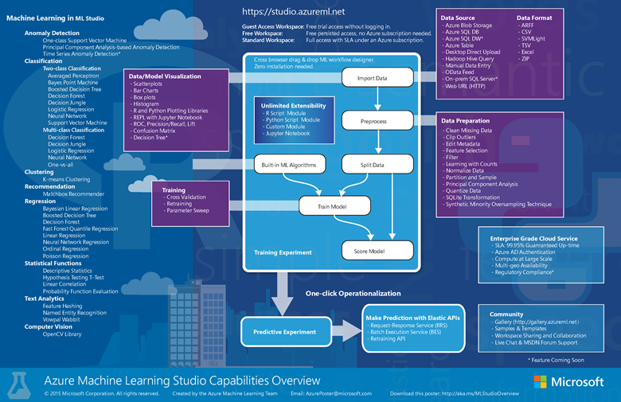
https://azure.microsoft.com/en-us/documentation/articles/machine-learning-studio-overview-diagram/

Slide 13
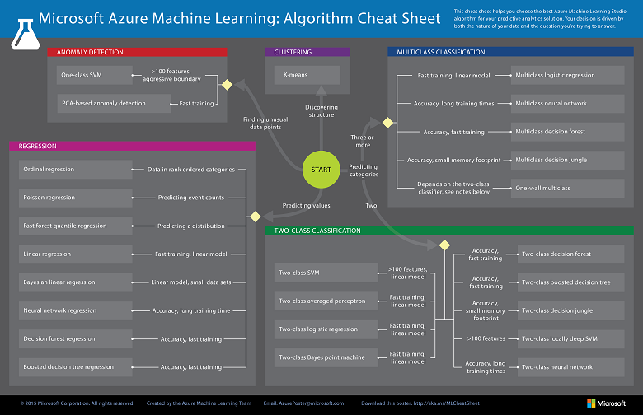
https://azure.microsoft.com/en-us/documentation/articles/machine-learning-algorithm-cheat-sheet/

